Slide 1
Heuristic Evaluation Report
Group G2-04

Slide 2
Topics
Website
User Profiles
Evaluation Methodology
Environment
Positive Findings
Negative Findings

Slide 3
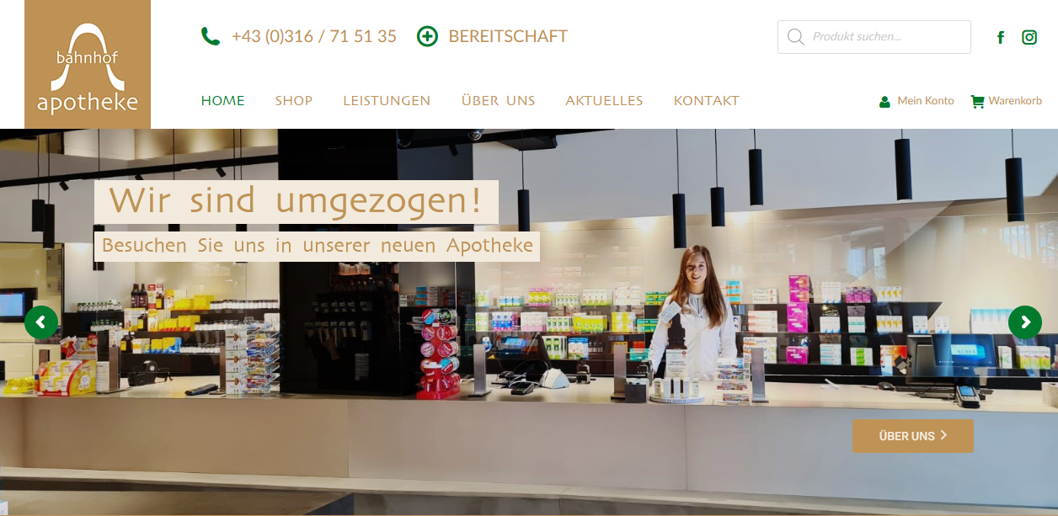
Website
https://www.bahnhof-apo.at

Slide 4
User Profiles
Think like typical user
People living in Graz
Potential users
Tech savvy people, bedridden people

Slide 5
Evaluation Methodology
Individual evaluations
Andrews General Usability Heuristic
Put together findings
Problems and positives rated
Report

Slide 6
Environment
Lenovo ThinkPad T14, Windows 10, Chrome 111.0.5563
HP Pavilion 15, Arch Linux, Firefox 111.0.1
iPhone 13 Pro, iOS 16.3.1, Firefox 111.1
iPhone 13 Pro, iOS 16.1.1, Chrome 111.0.5563

Slide 7
Positive Findings
Visible product availability
Fixed navigation bar
Alternative pharmacies

Slide 8
Negative Findings
38 negative findings
Rated by severity
Top five listed

Slide 9
1. Faulty links
Specific links faulty
Lead to 404 page
Heuristic: Error Prevention

Slide 10
2. Site Navigation
Site missing links
Finding wish-list difficult
Heuristic: Flexibility and Efficiency of Use

Slide 11
3. Different Navigation Bar
Not consistent
Might confuse user
Heuristic: Consistency, Recognition Rather Than Recall

Slide 12
4. Pop-Up Buttons
Buttons cover information
Fixed place better
Heuristic: Aesthetic And Minimalist Design

Slide 13
5. Design Inconsistencies
Inconsistent design:
Slide Buttons
Differing bottom section
Decreases navigability
Heuristic: Aesthetic And Minimalist Design

